Slide 1

FRIEDRICH SCHILLER UNIVERSITY JENA
FACULTY OF PHYSICS AND ASTRONOMY
INSTITUTE FOR SOLID STATE THEORY AND OPTICS
Effect of Localized Rotation Errors on the
Deutsch–Jozsa Algorithm
Submitted in partial fulfillment of the requirements for the Internship Module
SUPERVISOR
ADVISOR
Prof. Dr. Martin Gärttner
Niklas Euler
Presented by
Abiy Zelalem Tegegne
Jena, Germany • August 2026

Slide 2
Outline
Motivation of the Study
Objectives of the Study
Significance of the Study
Theoretical Background
Methodology and Error Model
Results and Discussion
Conclusion
Questions

Slide 3
Motivation of the Study
•
To Understand how imperfect gate operations affect quantum-algorithm performance.
•
Determine why the same error has different effects at different circuit locations.
•
Connect quantum-computing theory with practical Python simulation.
02

Slide 4
Objectives of the Study
The study separates axis, angle, and location
1
Model
Implement coherent single-qubit rotations Rₓ(θ), Rᵧ(θ), and Rz(θ).
2
Localize
Insert each error separately at E₁, E₂, E₃, and E₄.
3
Measure
Sweep θ and evaluate the probability P(0ⁿ).
4
Compare
Identify robust and vulnerable stages of the algorithm.
03

Slide 5
Significance of the study
1 . Identifies the circuit locations most sensitive to coherent rotation errors.
2. Provides insight into how localized gate imperfections affect algorithm performance.
3. Shows that error effects depend on both the rotation axis and the position of the error
.

Slide 6
The Deutsch–Jozsa algorithm
f : {0,1}ⁿ → {0,1}
Boolean Function
Constant
Balanced
f(x) has the same value
for every input x.
f(x) = 0 for half the inputs
and f(x) = 1 for the other half.
Task
Determine with certainty whether the function is constant or balanced.
04

Slide 7
Continued…
Quantum interference compresses many function values into one query
To decide with certainty
Classical deterministic(worst case)
Deutsch–Jozsa quantum algorithm
2ⁿ⁻¹ + 1
1
oracle query
oracle queries
The advantage comes from superposition and interference not from reading every f(x).
05

Slide 8
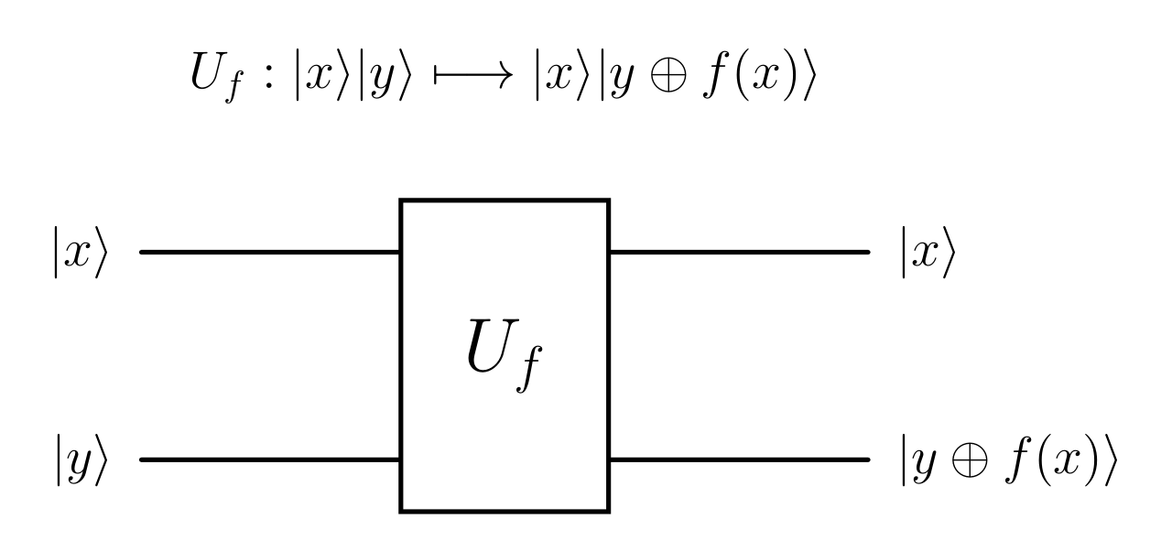
Oracle Representation
x is unchanged; the ancilla changes from y to y ⊕ f(x). One passage through $U_{f}$ is one oracle query.
06
Notes:
[1] R. Loredo, Learn Quantum Computing with Python and IBM Quantum, Birmingham: Packt Publishing Ltd, 2025.

Slide 9
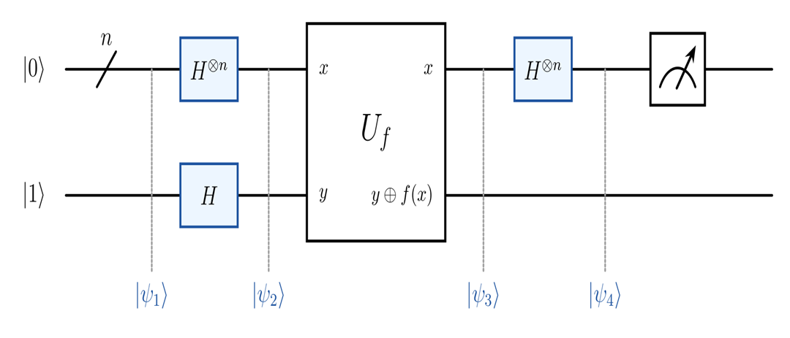
Ideal Deutsch–Jozsa Circuit
Decision rule
Constant
P(0ⁿ) = 1
Balanced
P(0ⁿ) = 0
Circuit logic
Superposition → oracle → interference → measurement
07
Notes:
[2] D. Deutsch and R. Jozsa, “Rapid solution of problems by quantum computation,” Proceedings of the Royal Society of London. Series A: Mathematical and Physical Sciences, vol. 439, no. 1907, pp. 553–558, 1992.

Slide 10



How One Query is Decoded
1
2
3
4
Prepare
Superpose
Encode
Interfere
${\text{|}\text{0}\text{⟩}}^{\text{⊗}n}$|1⟩
$H^{\text{⊗}n}$creates a superposition of all $2^{n}$ inputs.
oracle adds phases (−1)ᶠ⁽ˣ⁾
The final $H^{\text{⊗}n}$ combines the amplitudes.
08

Slide 11
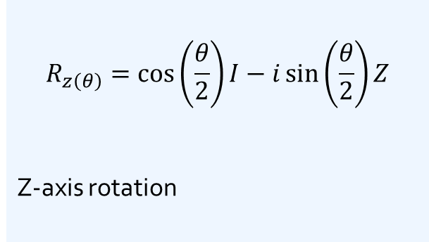
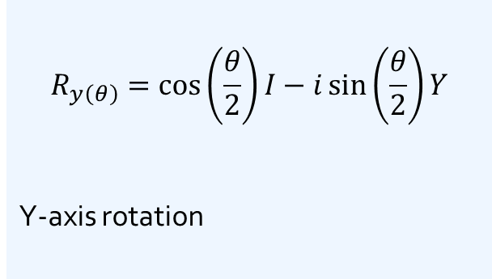
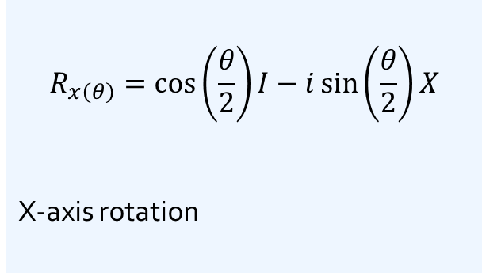
Three coherent single-qubit rotation operator
$$R_{a\left(θ\right)}=cos\left(\frac{θ}{2}\right)I − isin\left(\frac{θ}{2}\right)σ_{a}, a∈\left\{x,y,z\right\}, σx=X, σy=Y, σz=Z$$
$$R_{x\left(θ\right)}=\cos\left(\frac{θ}{2}\right)I−i\sin\left(\frac{θ}{2}\right)X$$
X-axis rotation
$$R_{y\left(θ\right)}=\cos\left(\frac{θ}{2}\right)I−i\sin\left(\frac{θ}{2}\right)Y$$
Y-axis rotation
$$R_{z\left(θ\right)}=\cos\left(\frac{θ}{2}\right)I−i\sin\left(\frac{θ}{2}\right)Z$$
Z-axis rotation
Coherent error
θ controls the error magnitude, while a ∈ {x, y, z} specifies the rotation axis.
09

Slide 12
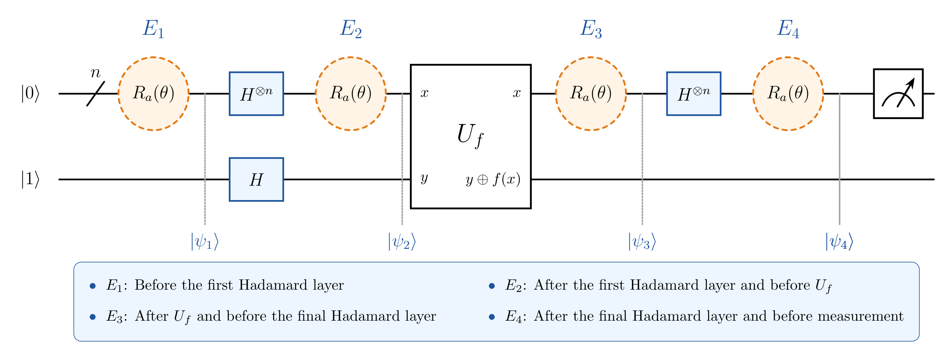
Error Modal
10
Notes:
[2] D. Deutsch and R. Jozsa, “Rapid solution of problems by quantum computation,” Proceedings of the Royal Society of London. Series A: Mathematical and Physical Sciences, vol. 439, no. 1907, pp. 553–558, 1992.

Slide 13
Simulation Methodology
Error implementation
Simulation parameters
•
Apply one localized rotation to one selected data qubit.
•
Input qubits: n = 9; target q=4.
•
Test Rₓ(θ), Rᵧ(θ), and Rz(θ) separately.
•
Angle: 0°–180° in 20° increments.
•
Repeat independently at E₁, E₂, E₃, and E₄.
•
1024 measurement shots per circuit execution.
Environment
Python • NumPy • SciPy • Matplotlib • JupyterLab • Git
11

Slide 14
Results and Discussion
Rotation-error sensitivity depends on the axis and circuit location
Nine plots compare P(0…0) for two constant functions and one balanced function under Rx​(θ), Ry​(θ), and Rz​(θ) errors.
13

Slide 15
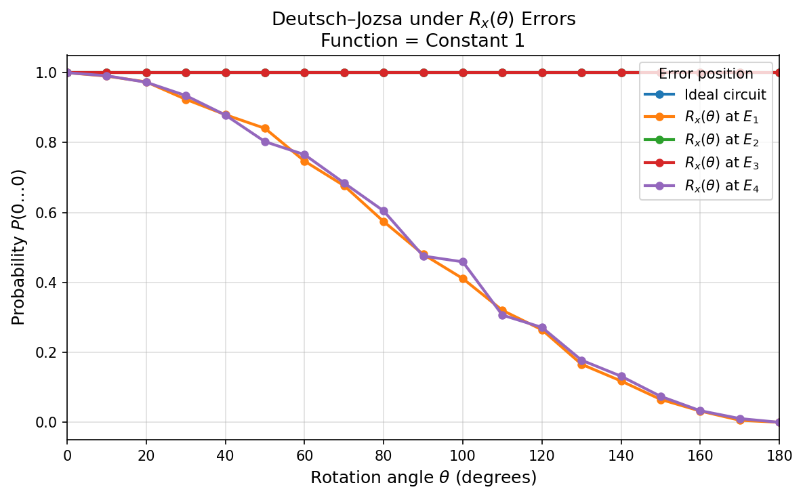
Continued…
X-axis rotation
•
E₁ and E₄ degrade together from P(0ⁿ)≈1 toward 0.
•
E₂ and E₃ remain close to the ideal curve.
•
At intermediate stages, X-basis eigenstates turn the rotation mainly into phase.
Most sensitive: state preparation and pre-measurement
Each plotted rotation uses the angle sweep θ = 0°…180°
14

Slide 16
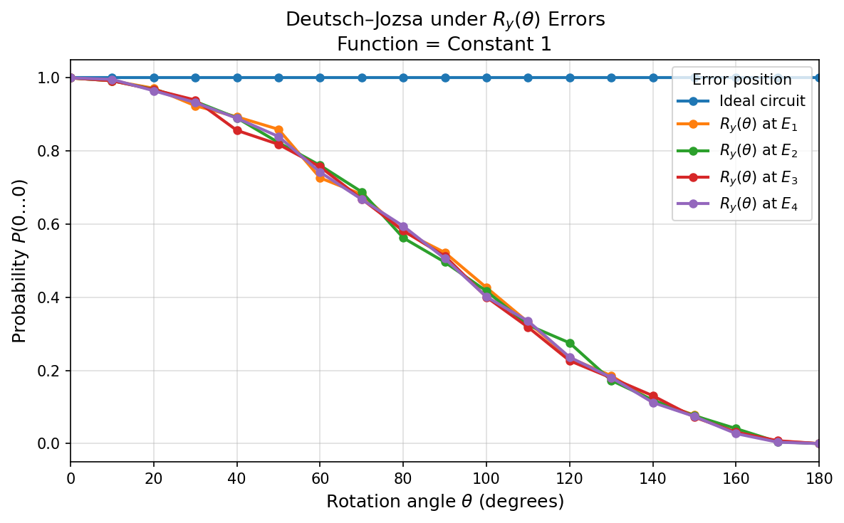
Continued…
Y-axis rotation
•
All four error-location curves nearly overlap.
•
P(0ⁿ) decreases steadily as θ approaches 180°.
•
Rotation angle dominates; no location is substantially protected.
Uniform location sensitivity
Each plotted rotation uses the angle sweep θ = 0°…180°
15

Slide 17
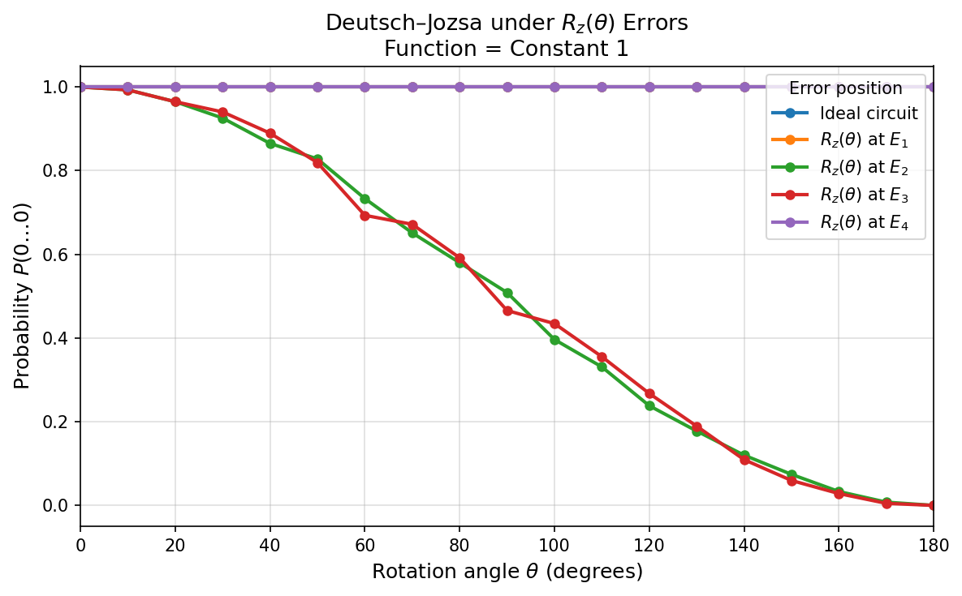
Continued…
Z-axis rotation
•
E₁ and E₄ remain essentially ideal.
•
E₂ and E₃ lose probability as θ increases.
•
Relative phase changes inside the interference region alter the final outcome.
Most sensitive: oracle input and oracle output
Each plotted rotation uses the angle sweep θ = 0°…180°
16

Slide 18
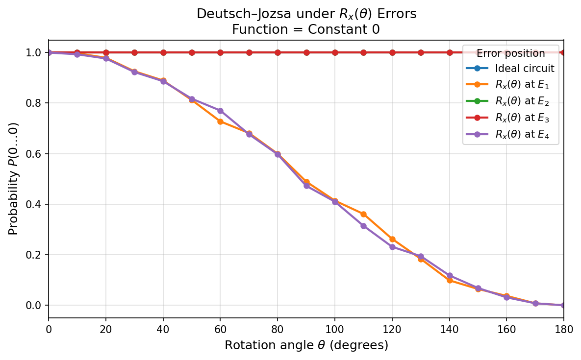
Continued…
X-axis rotation
•
E₁ and E₄ again show the dominant degradation.
•
E₂ and E₃ remain near the ideal result.
•
The location pattern is not specific to the constant output value.
Robust pattern across both constant functions
Each plotted rotation uses the angle sweep θ = 0°…180°
17

Slide 19
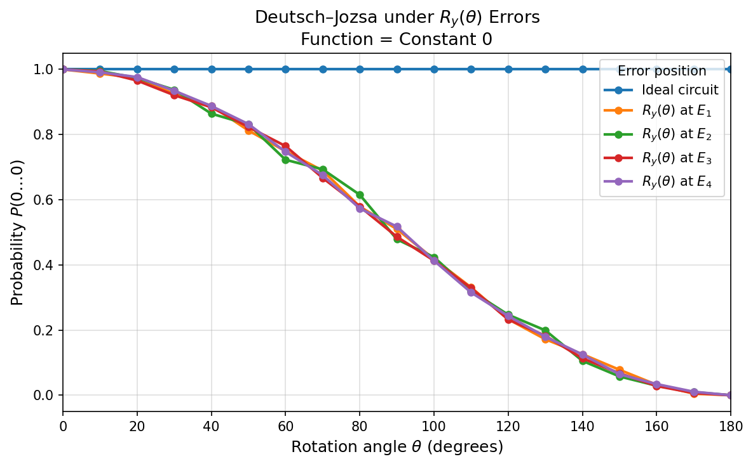
Continued…
Y-axis rotation
•
All locations decrease along nearly the same trajectory.
•
Differences are consistent with finite-shot fluctuations.
•
Angle remains more important than position for Y rotations.
Y response is location-independent
Each plotted rotation uses the angle sweep θ = 0°…180°
18

Slide 20
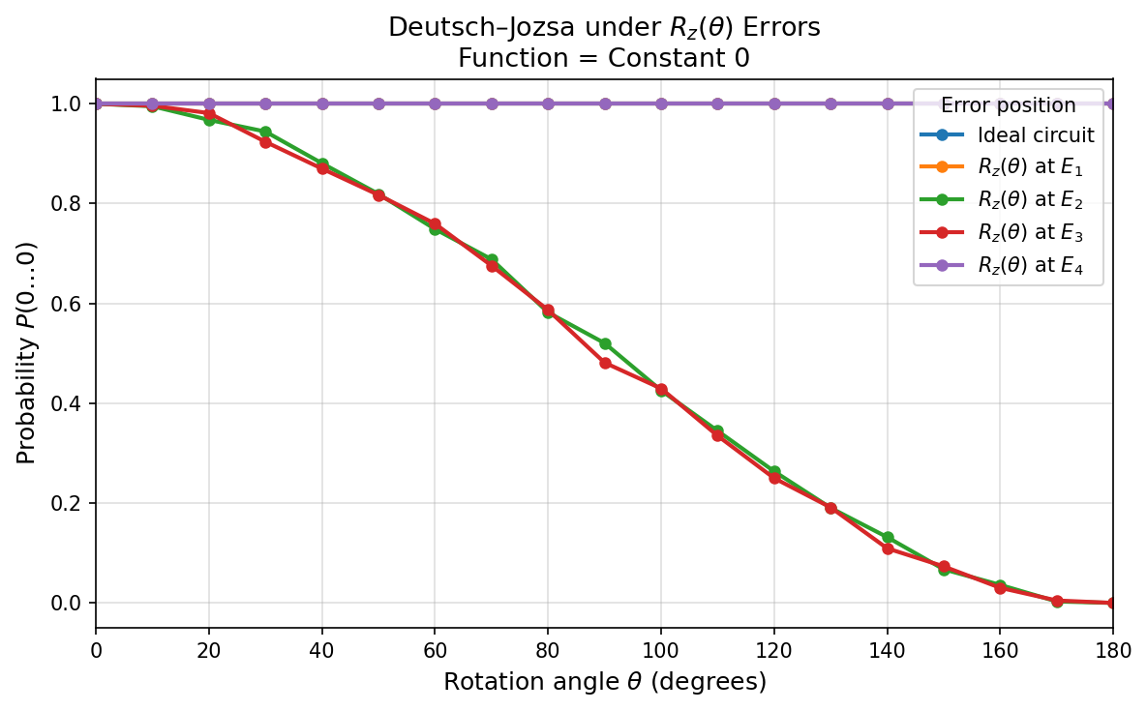
Continued…
Z-axis rotation · constant 0
•
E₂ and E₃ are again the vulnerable positions.
•
E₁ and E₄ stay near P(0ⁿ)=1.
•
The same phase-sensitive mechanism holds for both constant oracles.
Each plotted rotation uses the angle sweep θ = 0°…180°
19

Slide 21
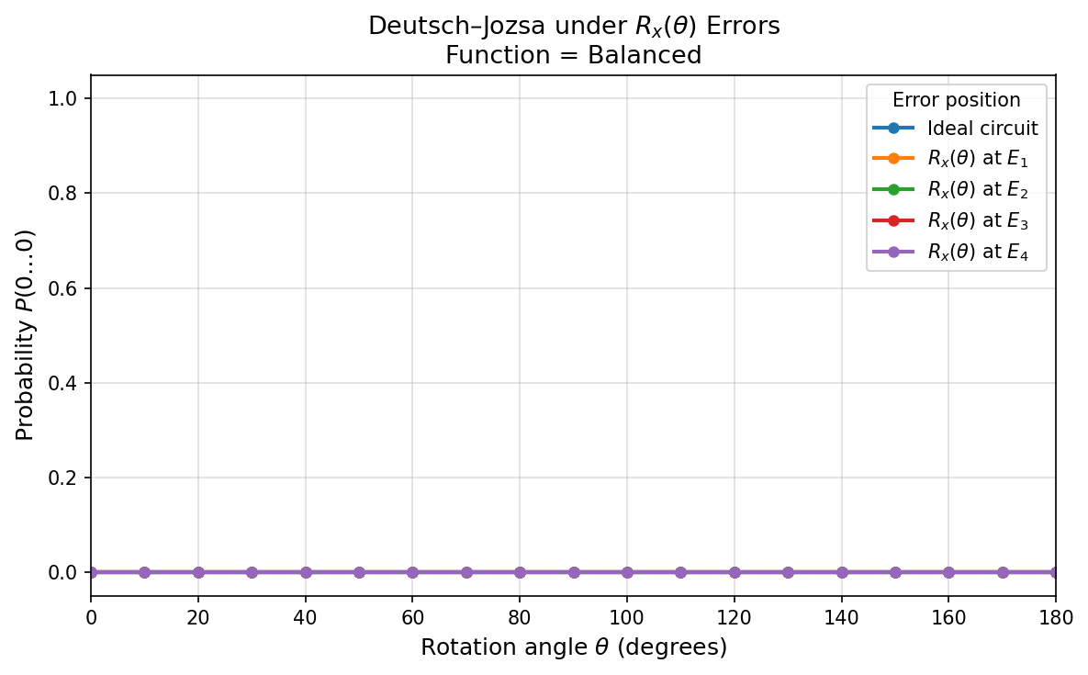
Continued…
X-axis rotation · balanced
•
P(0ⁿ) remains approximately zero for all locations and angles.
•
All curves overlap with the ideal balanced result.
•
This metric does not reveal changes among nonzero bit strings.
Each plotted rotation uses the angle sweep θ = 0°…180°
20

Slide 22
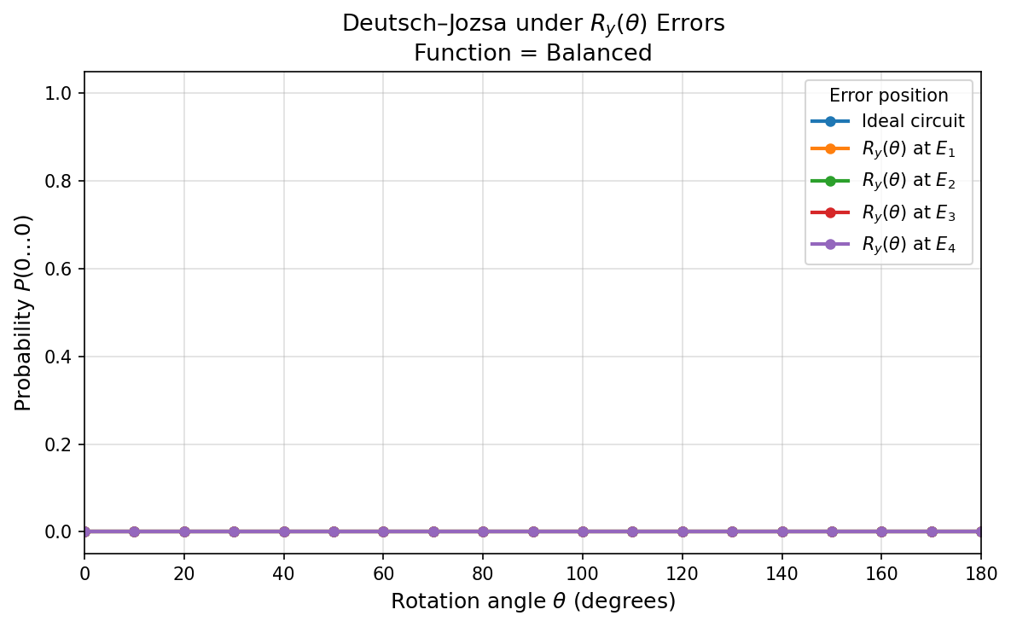
Continued…
Y-axis rotation · balanced
•
The all-zero probability stays at numerical zero.
•
No axis–location dependence appears in P(0ⁿ).
Each plotted rotation uses the angle sweep θ = 0°…180°
21

Slide 23
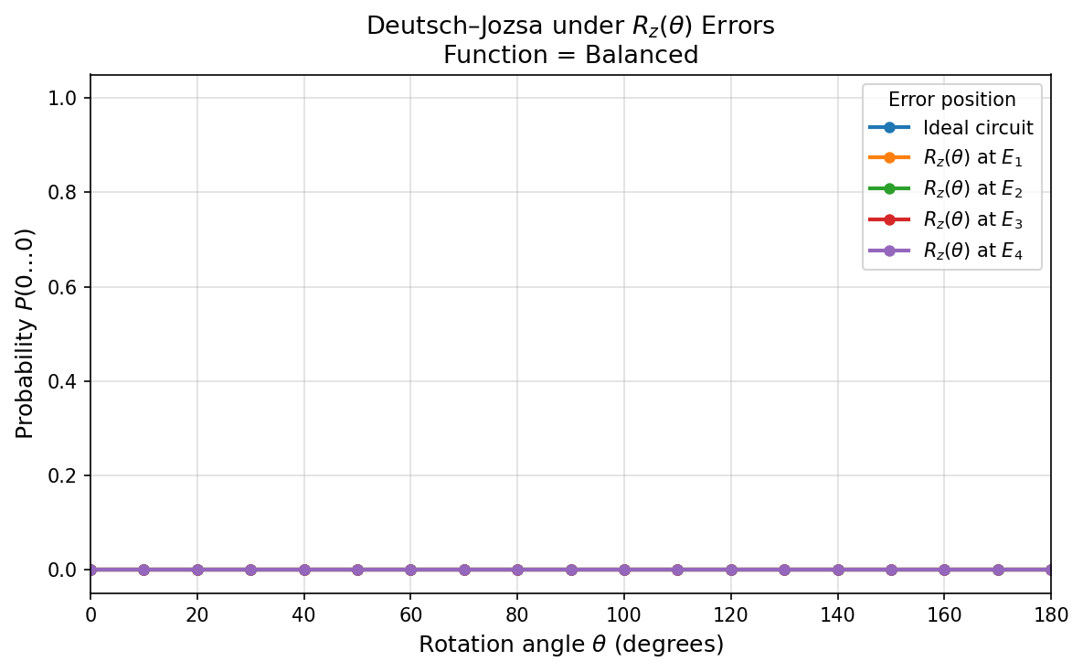
Continued…
Z-axis rotation · balanced
•
P(0ⁿ) remains approximately zero throughout the sweep.
Each plotted rotation uses the angle sweep θ = 0°…180°
22

Slide 24
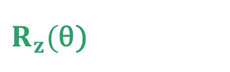
Cross-Result
Each axis has a distinct vulnerability map
Rotation
E₁
E₂
E₃
E₄
Rₓ(θ)
HIGH
LOW
LOW
HIGH
Rᵧ(θ)
HIGH
HIGH
HIGH
HIGH
$R_{z}($θ)
LOW
HIGH
HIGH
LOW
Interpretation
X errors attack circuit boundaries; Z errors attack the interference region; Y errors affect all stages.
23

Slide 25
Scope and Limitations
What this study establishes
Limitations of the Study
•
The error axis and its circuit position matter the effect of errors.
•
The study uses a classical simulator rather than real quantum hardware.
•
Both constant functions behave similarly.
•
One selected input qubit; no multi-qubit errors.
•
Balanced-function classification is stable in tests.
•
The analysis is limited only on Deutsch–Jozsa algorithm.
•
Scalability beyond n=9 input qubits was not investigated here.
24

Slide 26
Conclusions
X
Affect preparation and pre-measurement stages
E₁ and E₄
Y
Treat the circuit as uniformly in all locations
E₁–E₄
Z
Affect the phase-sensitive interference region
E₂ and E₃
25

Slide 27
Thank You
Questions?

